Slide 1
Quarter Project
Lab A

Slide 2
Why the Quarter Project?
This project is to help you learn about how fishery scientists discover features of local populations and how they relate to global scale issues such as climate change.
Objectives:
Learn about homeostasis in shellfish
Design an experiment to test shellfish stress resilience
Identify shellfish populations through differential phenotypes
Explain your research to others clearly and concisely
Develop your skills as a fishery scientist

Slide 3
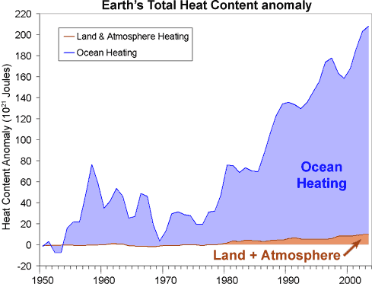
What are we investigating?
Shellfish inhabit a variety of habitats with diverse factors affecting their daily life.
Climate change will undoubtedly affect these animals abilities to persist.

Slide 4
Olympia Oysters
How many populations of Olympia oysters?
What might differentiate them?
What could have lead to these differences?

Slide 5
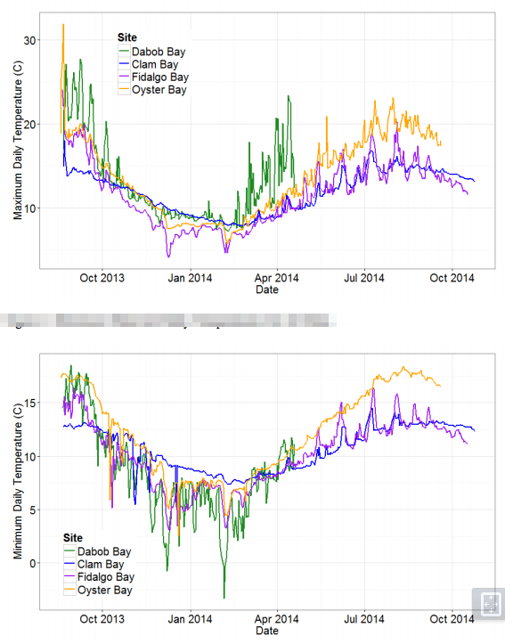

Slide 6
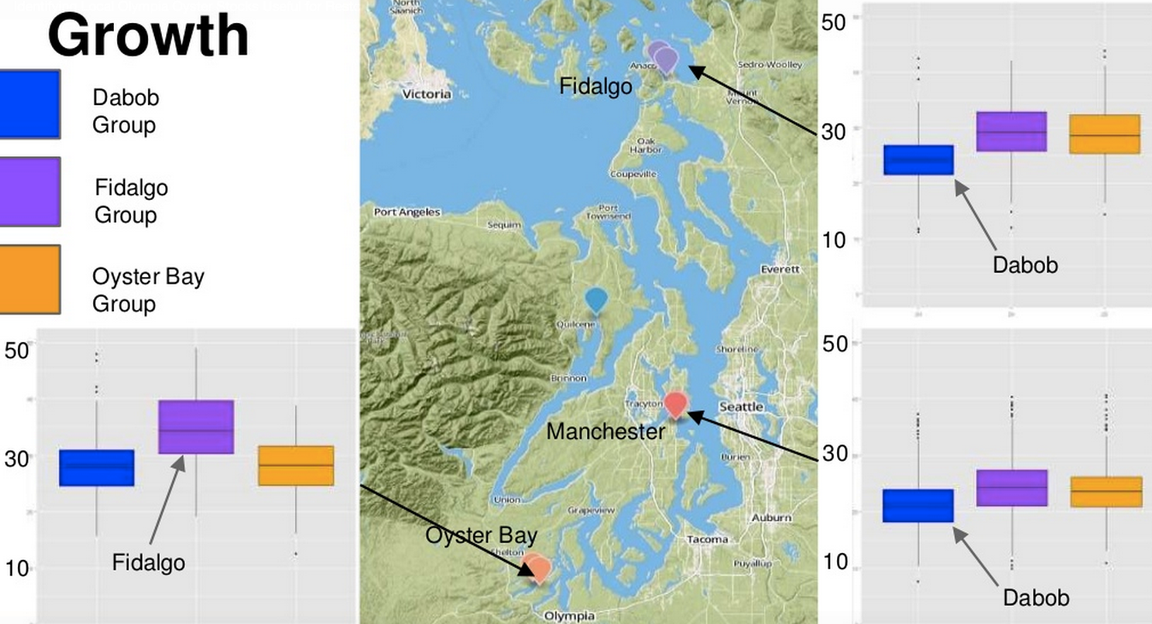
Growth

Slide 7
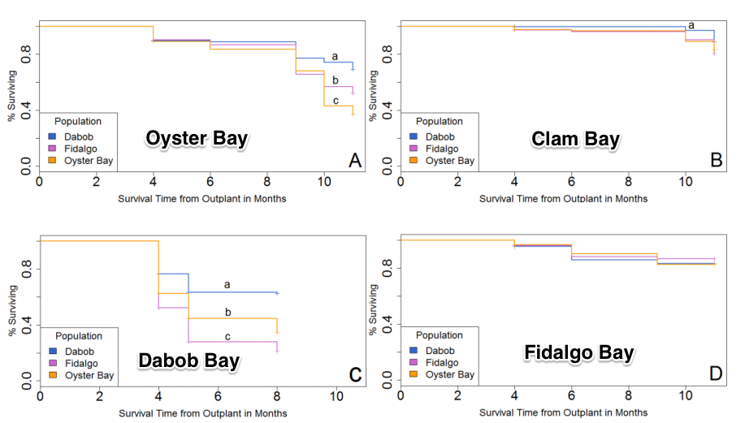
Mortality

Slide 8
Olympia Oysters
How many populations of Olympia oysters?
What might differentiate them?
What could have lead to these differences?

Slide 9
Hypothesis Creation
How might Olympia oysters respond to stress?
What could you measure?
How testable is your hypothesis?

Slide 10
Experimental Design
What do you need to run your experiment?
What do you have to control?
What can you not control?
How will you collect samples?
How will you generate data to test?

Slide 11
Homeostasis
What is Homeostasis?
Why is it important?
What is homeostasis in shellfish?
The ability of an organism to maintain physiological functions needed for survival.
Homeostasis is challenged by internal and external stressors.

Slide 12
Stress Resilience
What is Stress Resilience?
How can invertebrates resist stress?
What happens when they fail?
How would you test their stress resilience?

Slide 13

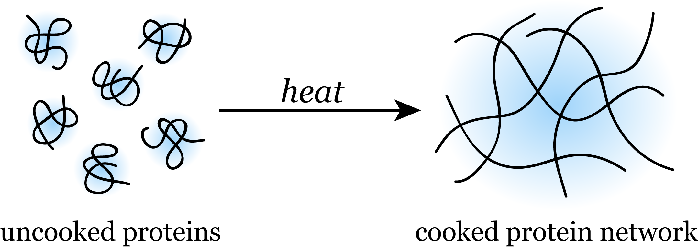
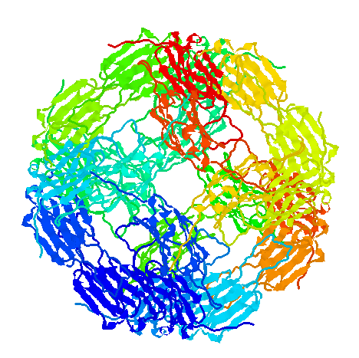
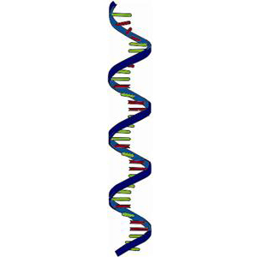
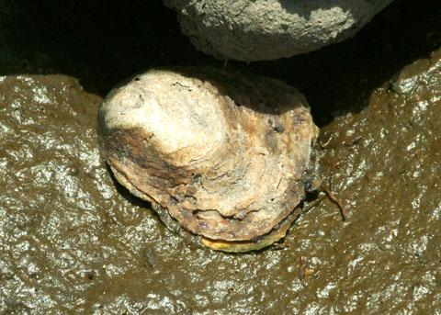

DNA vs The World
How might DNA be used to measure stress response?

Slide 14
Required Reading
The evolutionary and ecological role of heat shock proteins
Sorenson et al. 2003
Testing local and global stressor impacts on a coastal foundation species using an ecologically realistic framework
Cheng et al. 2015
Energy homeostasis as an integrative tool for assessing limits of environmental stress tolerance in aquatic invertebrates
Sokolova et al. 2012
MOSAIC PATTERNS OF THERMAL STRESS IN THE ROCKY INTERTIDAL
ZONE: IMPLICATIONS FOR CLIMATE CHANGE
Helmuth et al. 2006

